Slide 1

Sleep Health and Lifestyle BI Application
CISC 490 – Final Project
Analyst/Developer: Alejandro Koenen
Date: 12/3/25

Slide 2
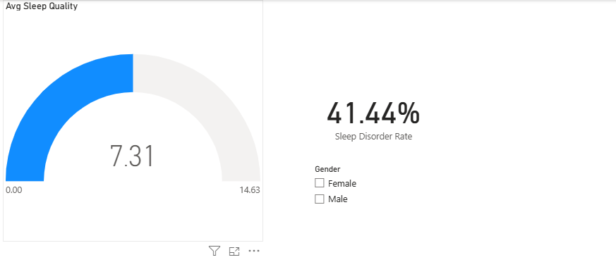
Business Intelligence Problem
Dataset: Sleep Health & Lifestyle (374 people, 13 original columns).
Main question:
Which lifestyle and occupation factors are associated with sleep quality and sleep disorders across occupations, shift exposure, and SOC groups?
Stakeholders:
Me (analyst/developer)
Students / sample population
Instructor (executive sponsor)
Decisions enabled:
Prioritize lifestyle changes (stress, steps, activity).
Highlight high-risk occupations/SOC groups.
Support wellness and policy recommendations.

Slide 3
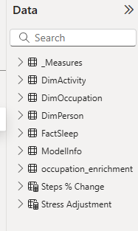
Types of Analytics Used
Descriptive
Distributions of sleep duration, quality, stress, steps, vitals, and disorder rates.
Used on: Data Quality, Occupation Outcomes, Shift-Work Exposure, SOC Group pages.
Diagnostic
Key Influencers + clustering to find risk factors and patterns.
Used on: Sleep Disorder Drivers, Lifestyle Clusters, occupation pages.
Predictive
Python logistic regression (AUROC ≈ 0.963).
Azure AutoML model (LightGBM/ensemble, AUC weighted ≈ 1.0, accuracy ≈ 58.5%).
What-If
Stress Adjustment & Steps % Change → Sleep Quality (Scenario).

Slide 4
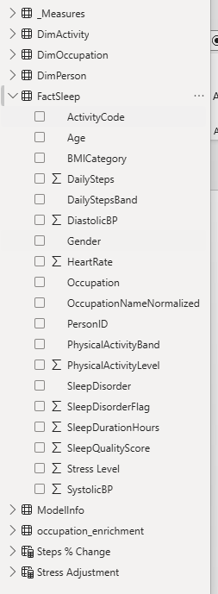
Datasets Used
Primary Kaggle dataset
PersonID, Gender, Age, Occupation
Sleep Duration, Sleep Quality, Activity, Stress
BMI Category, Blood Pressure, Heart Rate, Daily Steps
Sleep Disorder (None / Sleep Apnea / Insomnia)
Occupation enrichment (occupation_enrichment.csv)
OccupationNameNormalized
SOCMajorGroup
ShiftWorkRiskPct → used to create ShiftRiskBand (Low/Moderate/High).
Azure ML training dataset (FactSleep_for_Azure.csv)
Cleaned FactSleep export + SleepDisorderFlag (0/1) for AutoML.

Slide 5
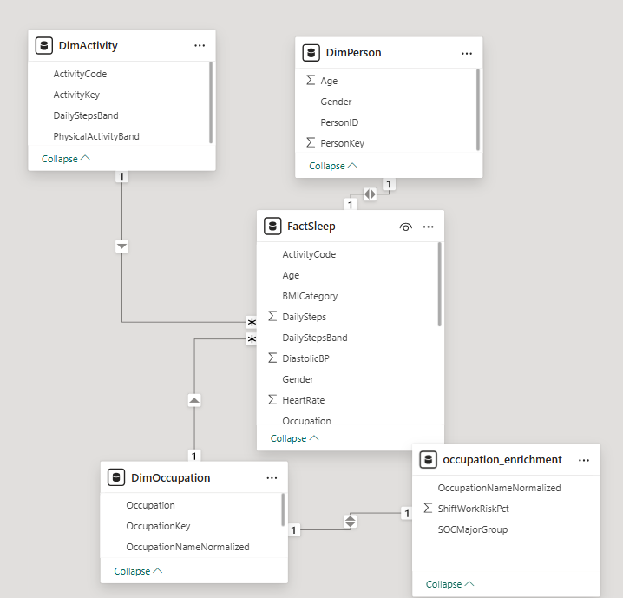
Data Model (Star Schema, Fact, Dimensions, Measures)
Grain: 1 row per person in FactSleep.
FactSleep:
SleepDurationHours, SleepQualityScore
SleepDisorderFlag, SleepDisorder
Activity, Stress, DailySteps
BMICategory, SystolicBP, DiastolicBP, HeartRate
ActivityCode = PhysicalActivityBand & "-" & DailyStepsBand
Dimensions:
DimPerson (PersonID, Age, Gender)
DimOccupation (Occupation, OccupationNameNormalized, SOCMajorGroup, ShiftWorkRiskPct, ShiftRiskBand)
DimActivity (PhysicalActivityBand, DailyStepsBand, ActivityCode)
DimSOC (optional snowflake)
Measures in _Measures:
Core KPIs, scenario measures, Avg ShiftWork Risk %, Python Logistic AUROC, Azure AutoML AUC & Accuracy.

Slide 6
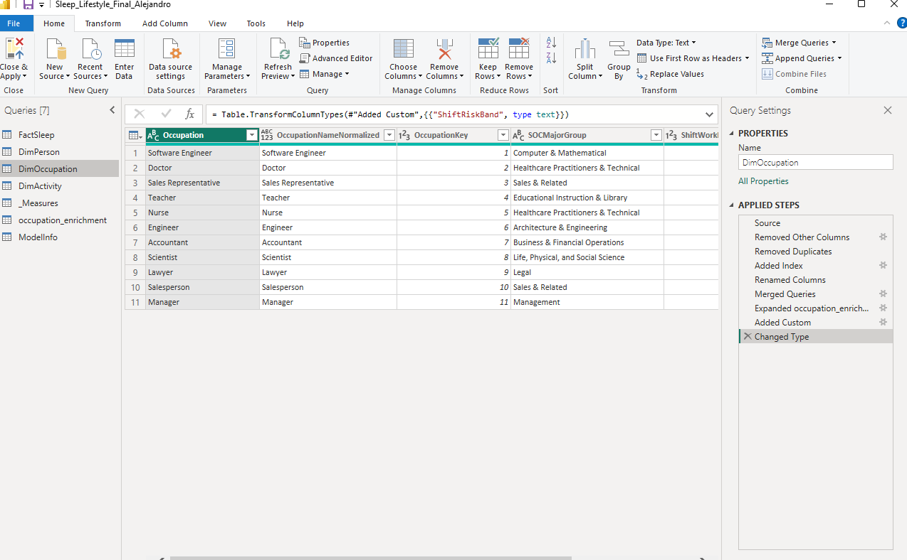
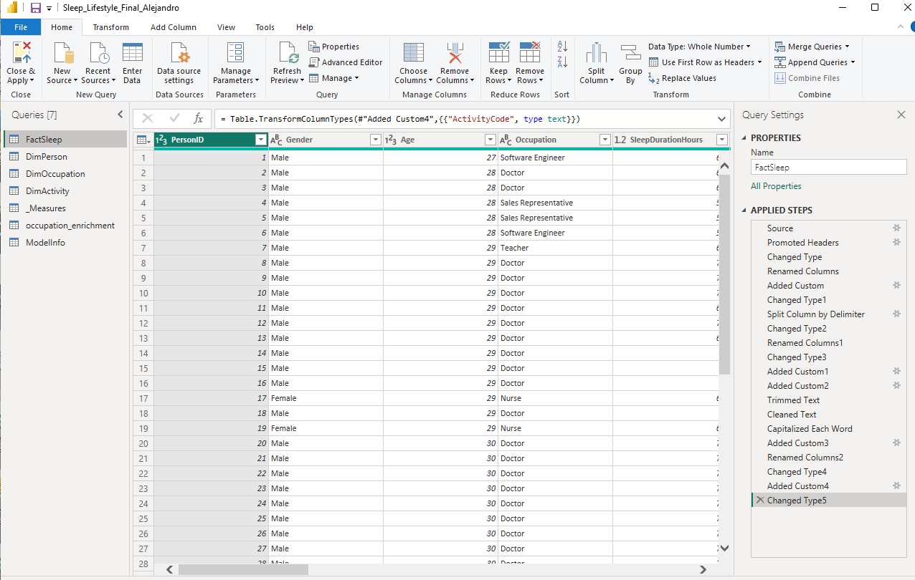
Data Preprocessing
Data Consolidation
Loaded Kaggle CSV into Power BI.
Loaded occupation_enrichment.csv into DimOccupation.
Exported FactSleep_for_Azure.csv for Azure ML.
Data Cleaning
Normalized occupations → OccupationNameNormalized.
Split BloodPressure → SystolicBP / DiastolicBP.
Validated ranges; confirmed no missing vitals.
Data Transformation
Created SleepDisorderFlag (0/1).
Binned Activity & Steps → PhysicalActivityBand, DailyStepsBand + ActivityCode.
Computed ShiftRiskBand from ShiftWorkRiskPct.
Data Reduction
Dropped unused raw fields.
Kept only fields used in visuals, measures, or exports.

Slide 7
High-Level System Architecture
Data Sources
Kaggle Sleep dataset, occupation enrichment CSV, Azure ML AutoML run.
Technical Staff
Student analyst (me): Power Query, modeling, DAX, Python, Azure ML.
Business & Exec Users
Classmates exploring the app.
Instructor acting as executive sponsor.
Environments
Data Warehouse: Power BI model (FactSleep + dims + _Measures).
Business Analytics: 8 report pages, Python visuals for ROC & clustering.
Performance & Strategy: KPIs, SOC/shift comparisons, Stress & Steps what-if.

Slide 8
Overview of Analyses (8 Total)
Data Quality & Prep – validate completeness & ranges.
Sleep Disorder Drivers – primary issue; Key Influencers + Python ROC.
Sleep Quality What-If – stress/steps sliders → scenario sleep quality.
Occupation Outcomes – by occupation (Sleep Disorder Rate, duration, quality).
Shift-Work Exposure vs Sleep – ShiftRiskBand vs outcomes.
SOC Group Comparison – SOCMajorGroup vs shift risk & sleep outcomes.
Lifestyle Cluster Profiles – Python k-means clusters.
Azure ML Model Comparison – Azure AutoML vs Python logistic metrics.
1 primary issue analysis (#2).
7 expanded analyses.
2 Python analyses (#2, #7).
1 Azure ML analysis (#8).

Slide 9
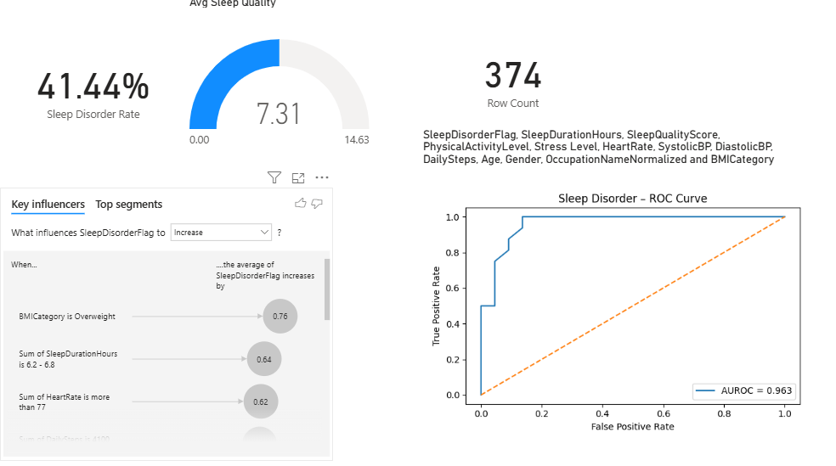
Primary Analysis – Sleep Disorder Drivers
Question: What drives the probability of having a sleep disorder?
Design considerations:
Identify key risk factors for SleepDisorderFlag.
Provide interpretable, ranked drivers.
Implementation features:
Key Influencers visual targeting SleepDisorderFlag.
Python logistic regression (scikit-learn) with ROC curve (AUROC ≈ 0.963).
KPI cards: Sleep Disorder Rate, Avg Sleep Quality, Row Count.
Key findings:
Overweight BMI, higher resting heart rate, shorter sleep, and higher stress are top drivers.

Slide 10
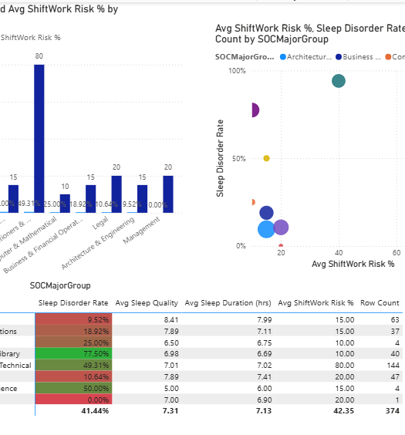
Occupation, Shift Risk, and SOC Analyses
Occupation Outcomes
Matrix + Top N chart → occupations with highest Sleep Disorder Rate.
Shows roles like Sales and Nursing as higher-risk.
Shift-Work Exposure vs Sleep
Uses ShiftWorkRiskPct + ShiftRiskBand (Low/Moderate/High).
High shift-risk band = higher disorder rate & slightly lower sleep quality.
SOC Group Comparison
Aggregates into SOCMajorGroup.
Scatter: Avg ShiftWork Risk % vs Sleep Disorder Rate by SOC group.

Slide 11
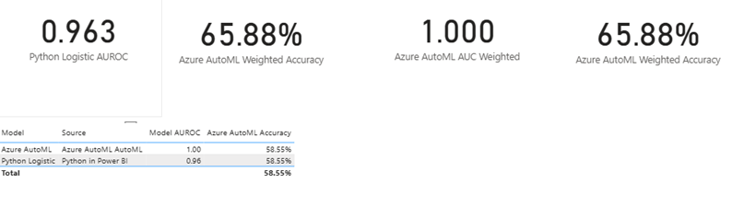
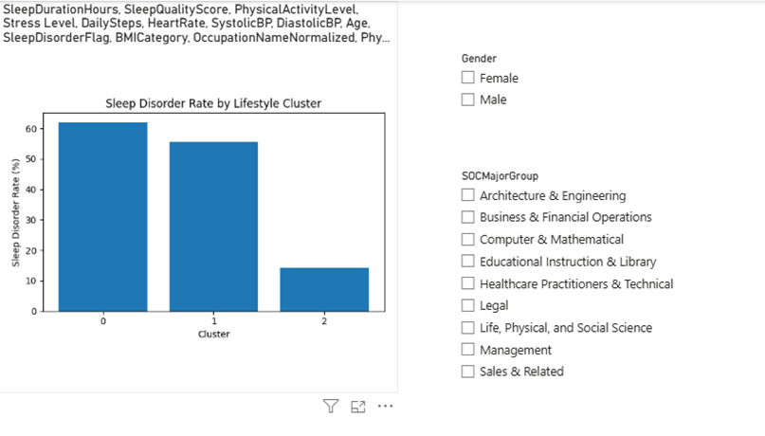
Lifestyle Clusters & Azure ML Model Comparison
Lifestyle Cluster Profiles (Python #2)
K-Means clustering on SleepDuration, SleepQuality, Activity, Stress, Steps, Vitals, Age.
Clusters show different Sleep Disorder Rates (e.g., “high-stress, low-sleep” vs “moderate, active”).
Azure ML Model Comparison
Azure AutoML classification on SleepDisorderFlag (FactSleep_for_Azure).
Best model metrics:
  AUC weighted ≈ 1.0
  Accuracy ≈ 58.5%
  Weighted accuracy ≈ 65.9%
Compared to Python logistic AUROC ≈ 0.963.
Rubric hit:
Python integration in 2 analyses (#2 & #7).
Azure ML trained model used in Analysis 8.

Slide 12

Key Takeaways & Future Work
Data quality is strong: no missing vitals; realistic ranges.
Drivers of sleep disorders: BMI, heart rate, sleep duration, and stress stand out.
Lifestyle levers: lower stress and more steps slightly improve scenario sleep quality.
Occupation & shift patterns: certain SOC groups and high-shift-risk jobs show higher Sleep Disorder Rates.
ML integration: Python and Azure AutoML models both perform well and agree on key risk factors.
Future work: more variables (caffeine, screen time), larger samples, time-series and more advanced ML analyses.

